Slide 2
Formatting
• Preparing a storage device for initial use
• Formatting process include three steps
– Low-level formatting
– Partitioning
– High-level formatting

Slide 3
Low Level Formatting
• Basic storage device preparation for data storing
• Lays the permanent foundation of the disk
• Completed at the factory by manufactures
• Create tracks and sectors

Slide 4
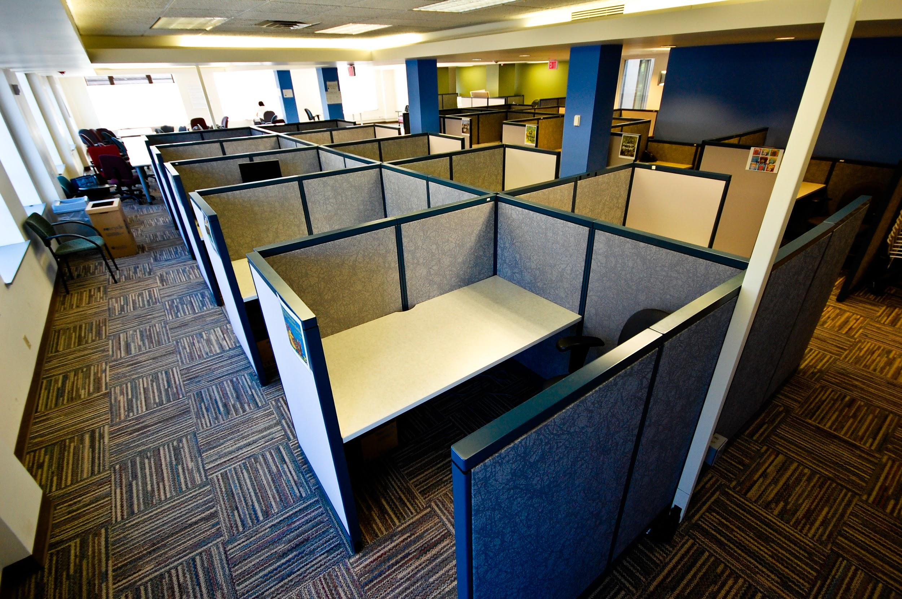
Disk Partitioning
• Creation of one or more regions on a hard disk or other secondary storage
• Operating system can manage information in each region separately.

Slide 5
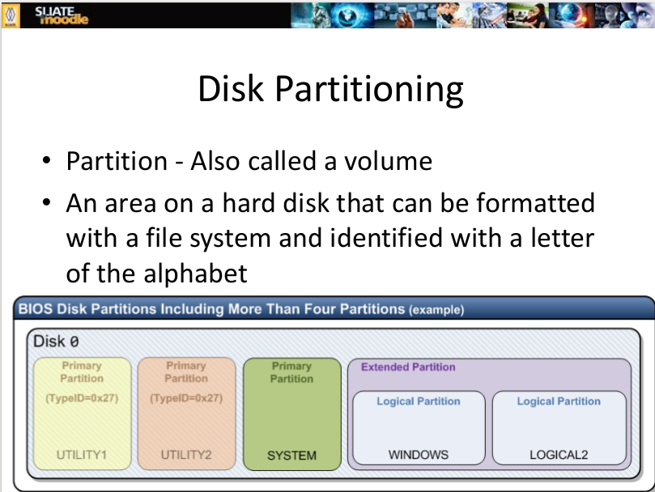

Slide 6
High Level Formatting
Data on disk are not fully destroyed during high-level formatting

